Slide 1

SPORTS CLUB MANAGEMENT SYSTEM
SPORTS
CLUB

Slide 2
ABOUT
Our SPORTS CLUB Management System is a sports and membership management system where you can keep records on your members and have quick and easy communication between you and your members .
SPORTS Management also includes a booking system and has a range of reports that help in the management of the club.
It provides lots of function such data entry of customer , keeping record of all the things about customers fees , plan , physical fitness which help to provide good quality of services to customer from club managers .
In this proposed system also provide the total information about machinery and data of coaches is also stored in it and services provided by Club is also handled by this system .

Slide 3
OBJECTIVES OF THE SPORTS CLUB MANAGEMENT SYSTEM
The main objective of the project is to develop a software that facilitates the data storage , data maintenance and its retrieval for the club in an igneous way
To store the record of the customers , the staff that has the privileges to access , modify and delete any record and finally the service , club provides to its customers .
Also , only the staff has the privilege to access any database and make the required changes , if necessary .
To develop easy to use software which handles the customer-staff relationship in a effective manner .
To develop a user friendly system that requires minimal user training . Most of features and function are similar to those on any windows platform .

Slide 4
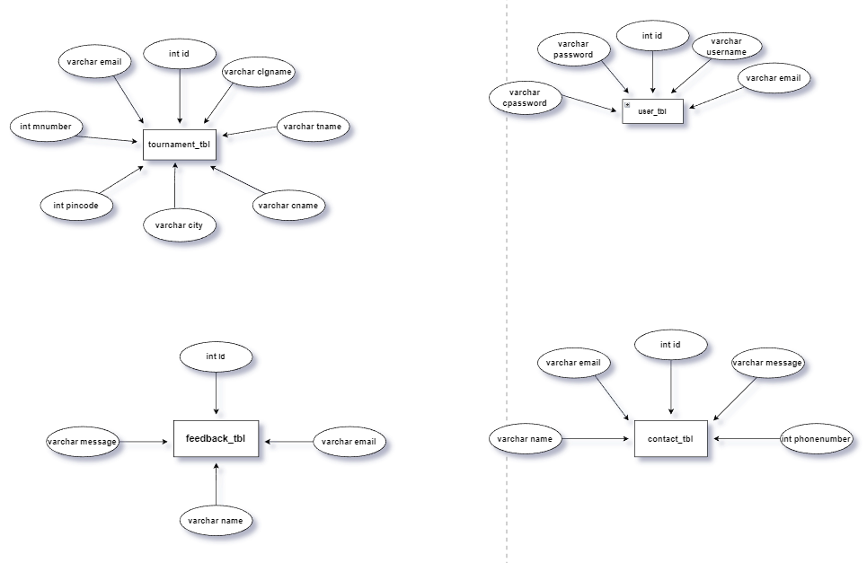
E-R DIAGRAM

Slide 5
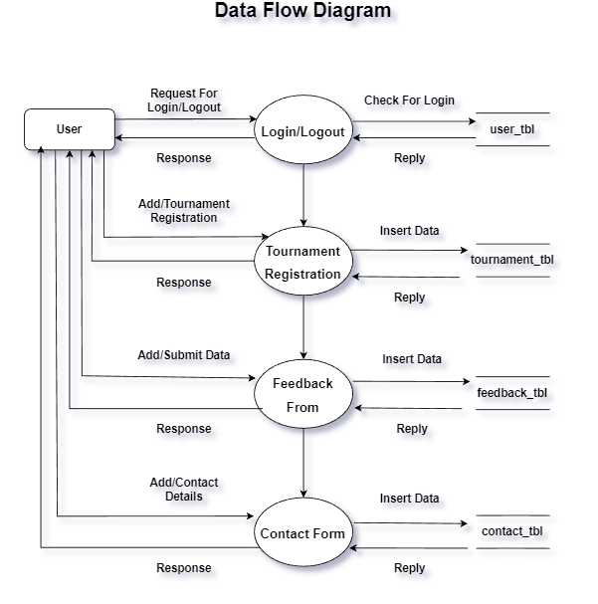
DATA FLOW DIAGRAM

Slide 6
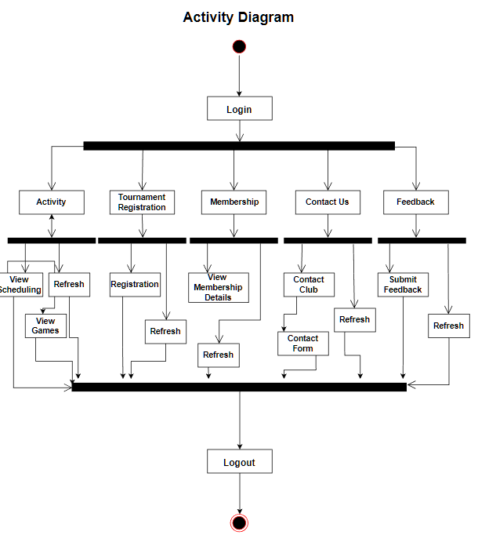
ACTIVITY DIAGRAM

Slide 7
NORMALIZATION
Database Normalization is a technique of organizing the data in the database. Normalization is a systematic approach of decomposing tables to eliminate data redundancy(repetition) and undesirable characteristics like Insertion, Update and Deletion Anomalies. It is a multi-step process that puts data into tabular form, removing duplicated data from the relation tables.
Normalization is used for mainly two purposes :
Eliminating redundant(useless) data.
Ensuring data dependencies make sense i.e data is logically stored.

Slide 8
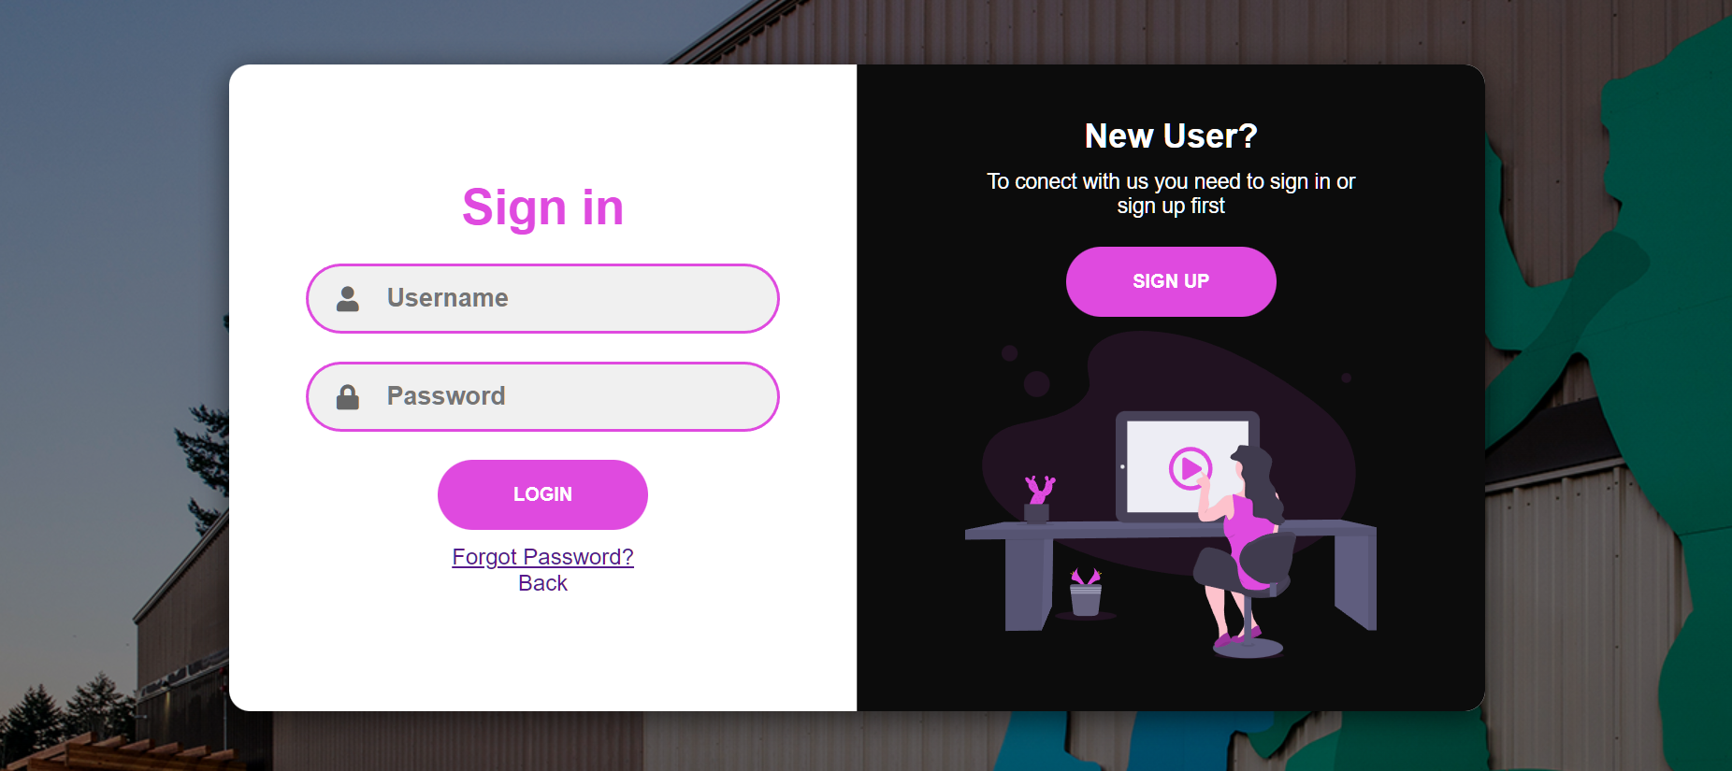
SCREENSHOTS

Slide 9
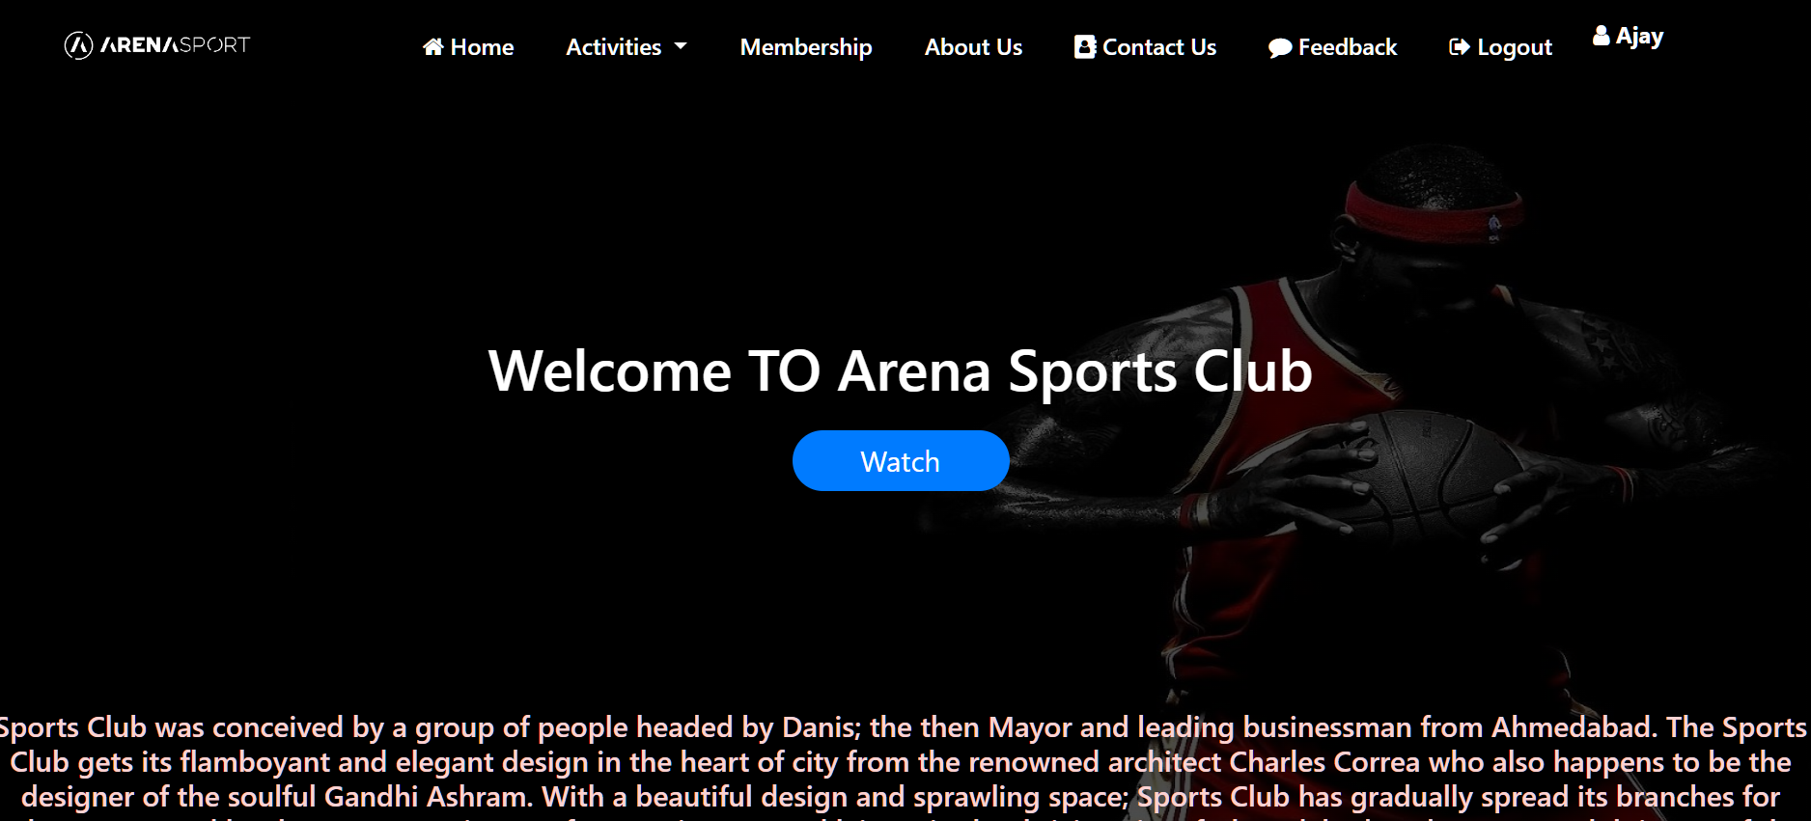
HOME PAGE

Slide 10
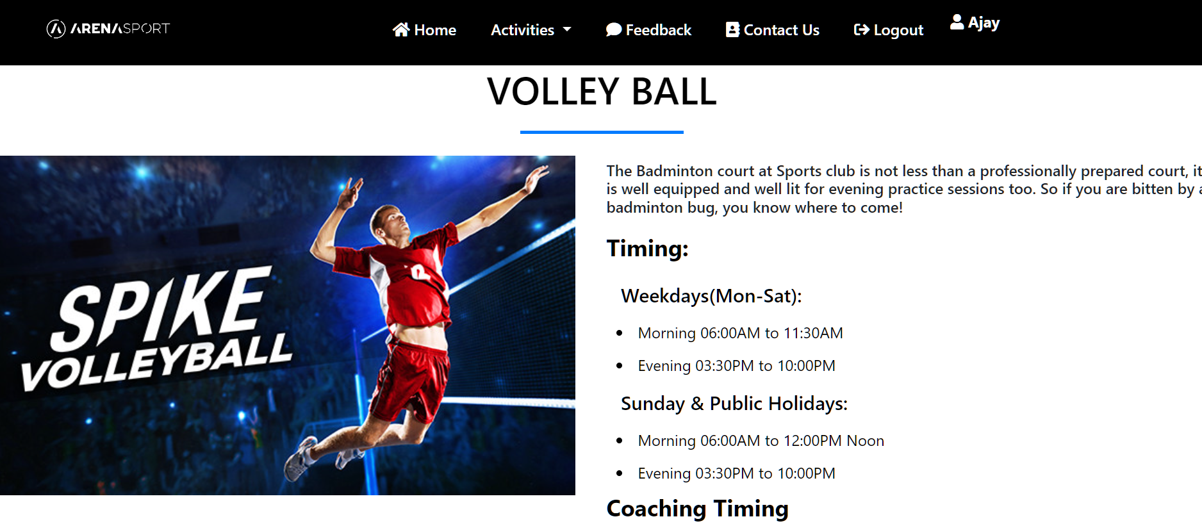
GAME PAGE

Slide 11
COMPUTERIZED SYSTEM ADVANTAGES
Faster processing
Centralized database helps in avoiding conflicts.
Easy to use GUI that does not require specific training.

Slide 12
SYSTEM SPECIFICATION
A high-level requirements specification is required. The purpose of the requirements analysis is to identify requirements for the proposed system. The emphasis is on the discovery of user requirements. Each requirement (or problem) must be defined and documented in the requirements catalogue. Each requirement is recorded in the requirements catalogue on a requirements catalogue entry form. A copy of the form is in the appendix section of the standards manual

Slide 13
HARDWARE & SOFTWARE
Hardware Interface:
Hardware requirements for running this project are as follows :
Processor: - Windows 11 64-bit.
RAM: - 128 MB or above.
HD: - 20 GB or above.
Software Interface:-
Software required to make working of product is :
Front end- HTML, CSS
Back end- PHP Mysql Database
Server - XAMPP

Slide 14
CONCLUSION
After implementing the application it will contain the advantages that are incomparable to the present contemporary systems used by company. The most admirable feature founded was its simplicity in terms of application to the user but its highly beneficial outputs can’t be ignored. The users will be highly benefited after using the system.
It is hoped that this project will help the future developers to modify and implement the system. After modifying some techniques of the programs, it will give us the best performance as our requirements. The project will be very useful for the users.

Slide 15
THANK YOU

